Slide 1

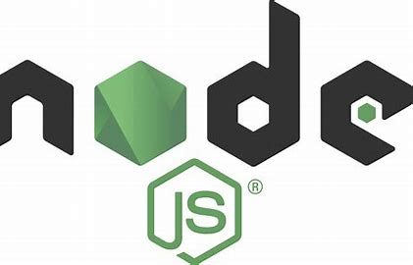

Azure Cosmos DB web apps with Node.js and TypeScript
Chris Joakim, Microsoft, Cosmos DB Global Black Belt (GBB)
https://www.linkedin.com/in/chris-joakim-4859b89

Slide 2
Presentation Outline
Meet Chris
Meet Azure Cosmos DB
The Azure Cosmos DB JavaScript/TypeScript SDK
Why TypeScript?
The azu-js Package @ NPM
The TypeScript/Express/Cosmos DB Web Application - code walkthrough and demo
Wrap up - Links and Other Repos of Interest

Slide 3
Meet Chris
2021 - Microsoft - Cosmos DB Global Black Belt (GBB)
2016 - Microsoft - Cloud Solution Architect
1986 - 2016 - Software Developer, CTO, Owner
Languages: COBOL -> Smalltalk -> Java -> Ruby on Rails (RoR) -> Node.js (MEAN) -> Python -> TypeScript. Use CoffeeScript with RoR and the MEAN stack.
Databases: IMS/DB, Relational (DB2, MySQL, PostgreSQL), MongoDB (2008), -> Cosmos DB (2017)
Preferences: Dynamic Languages and Schemaless JSON-based NoSQL
Davidson/Charlotte, NC, USA
LinkedIn: https://www.linkedin.com/in/chris-joakim-4859b89/
GitHub: https://github.com/cjoakim
Why did I Highlight CoffeeScript and MongoDB & Cosmos DB?

Slide 4
Meet Azure Cosmos DB
Cloud-Native family of NoSQL Databases
Born in the cloud
High Performance – single-digit ms queries
High Availability – multiple copies of your data, 99.99 to 99.999% SLA
Globally Replicated, on the high-speed Azure fiber network
APIs: NoSQL, Mongo, Mongo vCore, Cassandra, Cassandra MI, Gremlin
Dynamic Throughput Model with Request Units (RUs)
Enables you to “right size” your Cosmos DB account and costs
NoSQL API stores JSON Documents, but uses SQL for queries
Enables high-performance “end-to-end JSON” applications
Change-Feed for “event driven” apps with serverless Azure Functions
Synapse Link for analytics and batch
https://learn.microsoft.com/en-us/azure/cosmos-db/

Slide 5
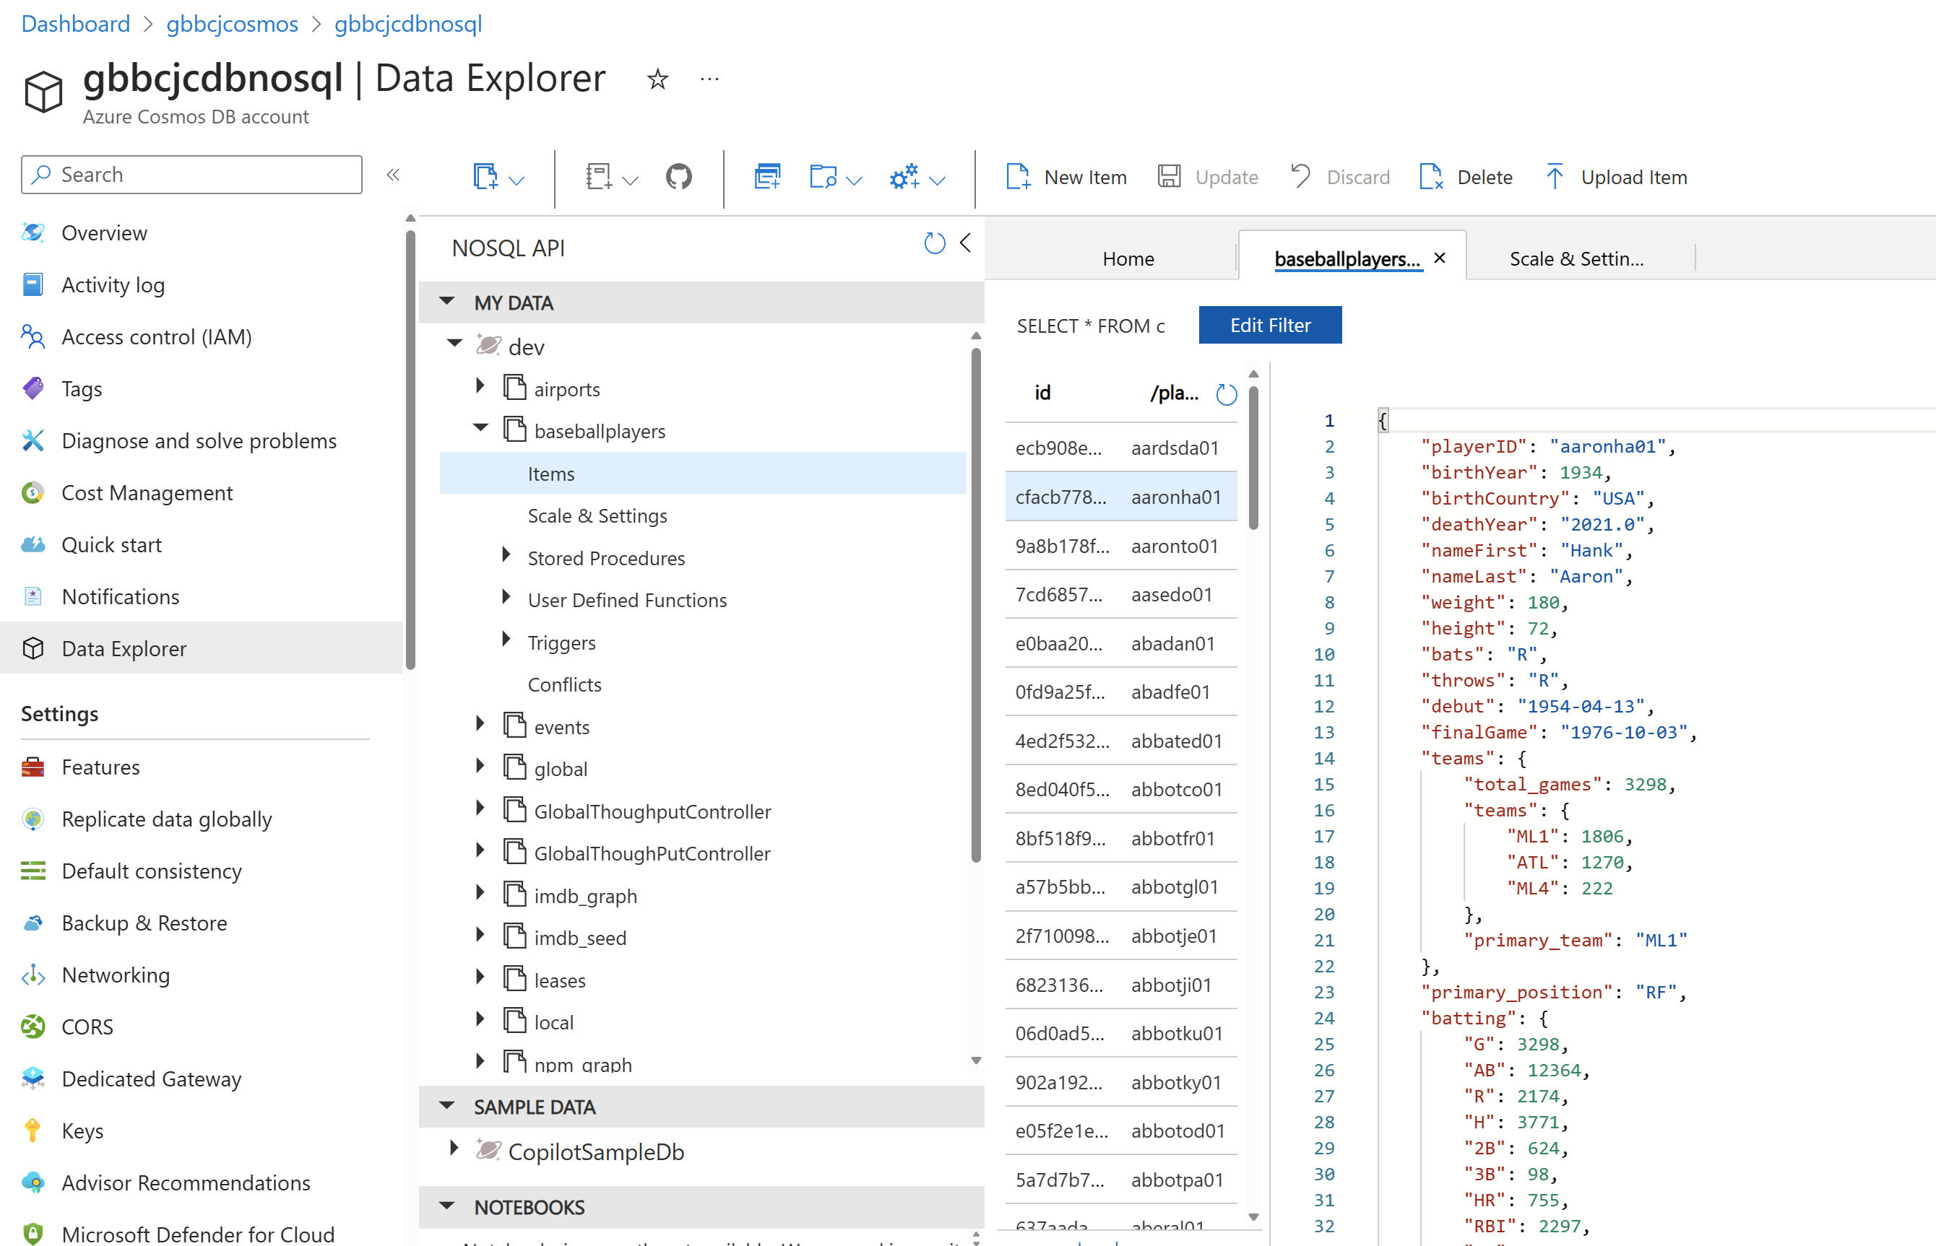
Azure Cosmos DB : Data Explorer in Azure Portal

Slide 6
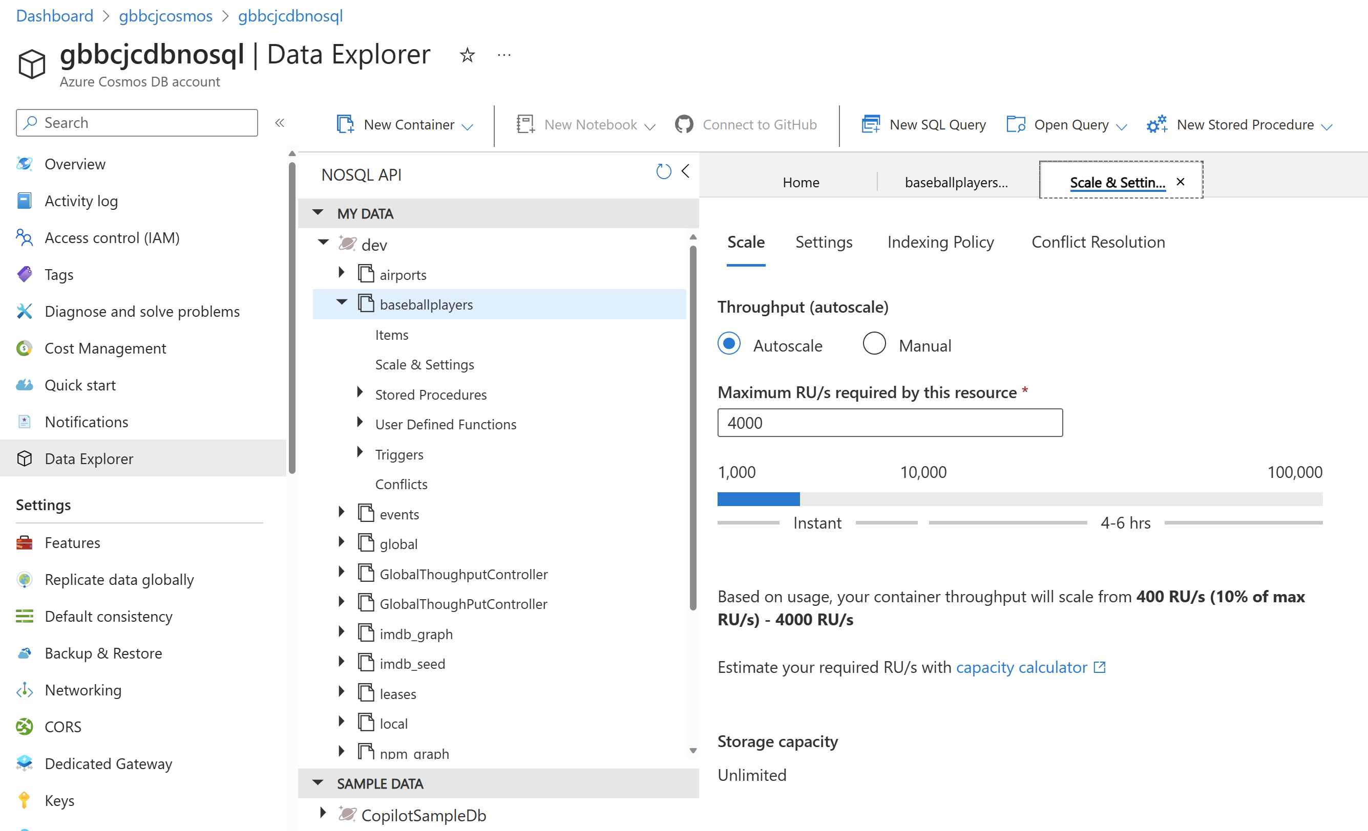
Azure Cosmos DB : Request Units and Autoscale

Slide 7
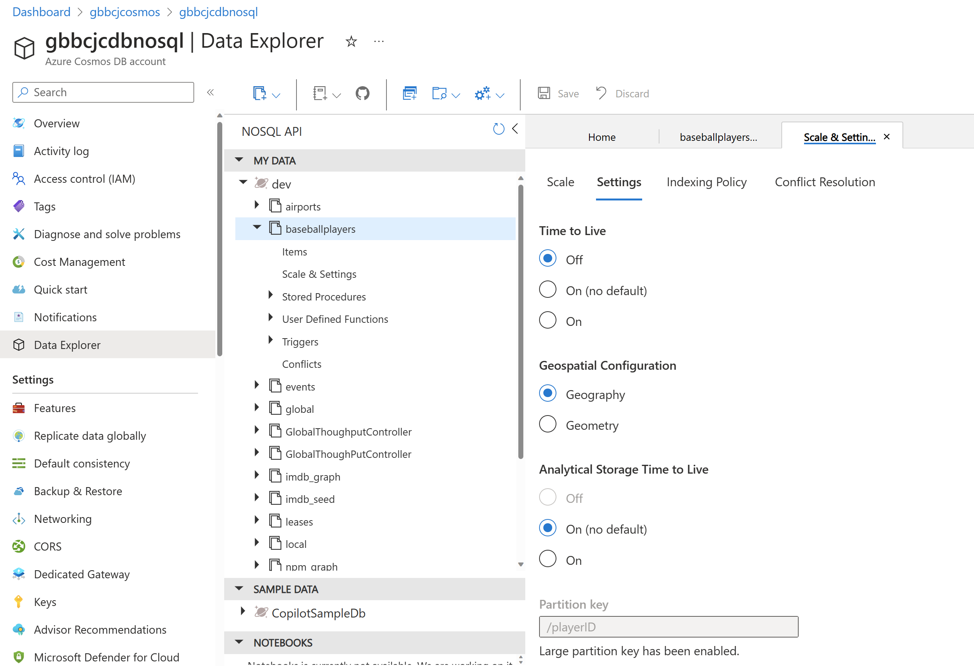
Azure Cosmos DB : TTL, Synapse Link, Partition Key Configuration

Slide 8
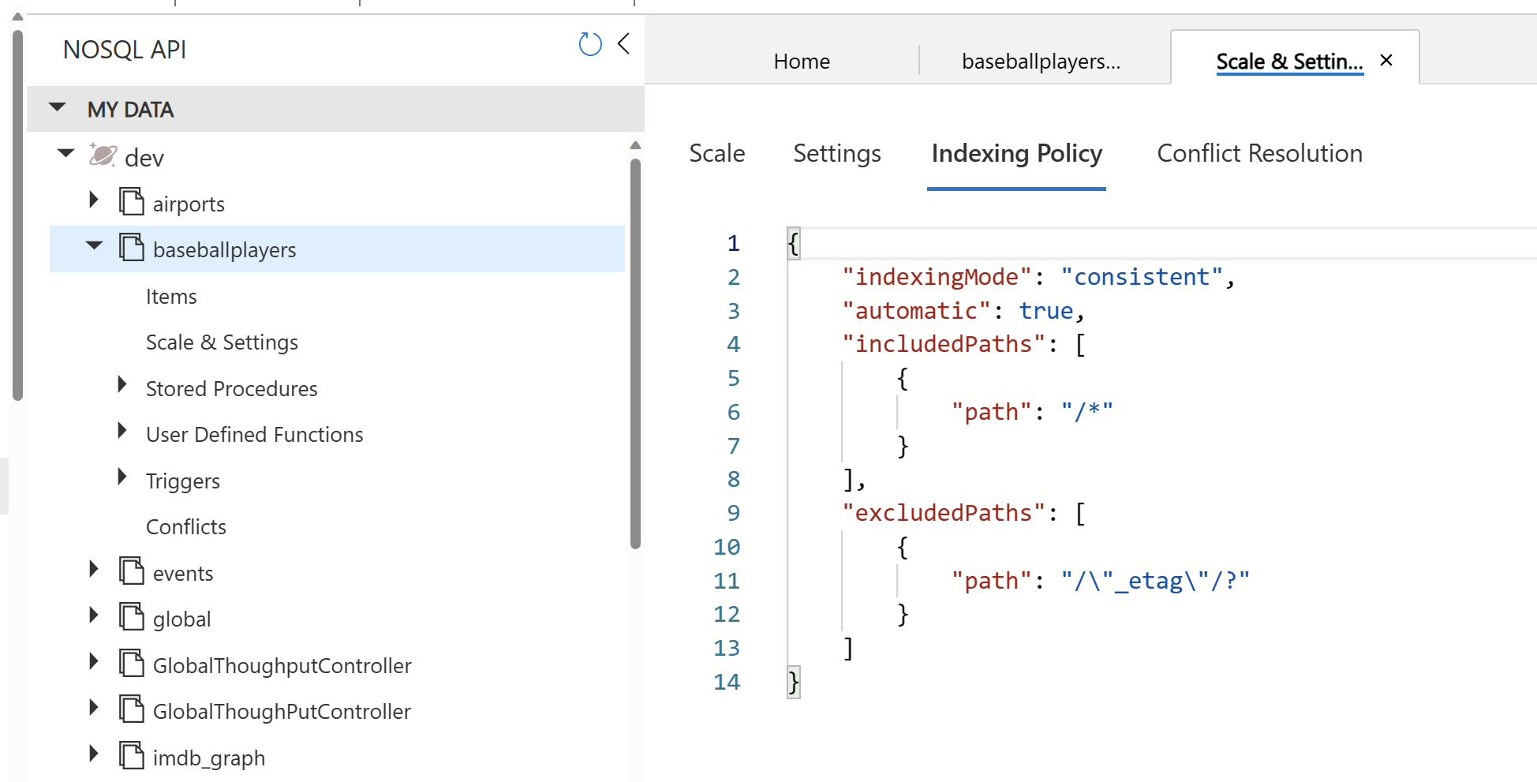
Azure Cosmos DB : Indexing – Defined with JSON, Defaults to /*

Slide 9
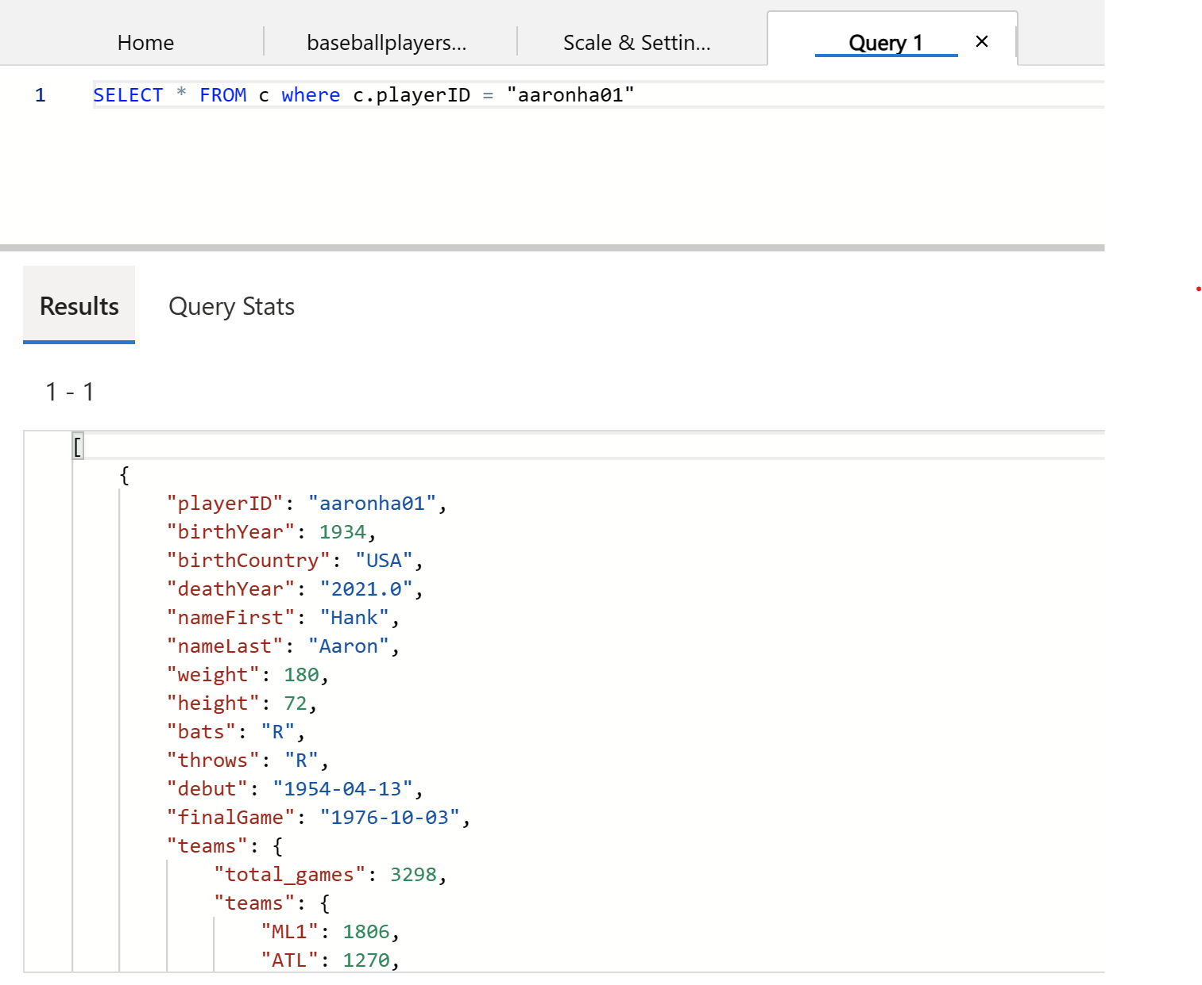
Azure Cosmos DB : Query with SQL

Slide 10
The Azure Cosmos DB JavaScript/TypeScript SDK
https://github.com/Azure/azure-sdk-for-js
https://github.com/Azure/azure-sdk-for-js/tree/main/sdk/cosmosdb/cosmos
https://www.npmjs.com/package/@azure/cosmos
The Cosmos DB JavaScript SDK is part of the Azure JavaScript SDK
It is written in TypeScript, and transpiled into JavaScript
Current Version is 4.0.0 – adds excellent features
Throughput Control, Hierarchical Partition keys, Async
Supports Asynchronous Operations – await/async
npm install @azure/cosmos
Other Links:
https://learn.microsoft.com/en-us/javascript/api/overview/azure/cosmos-readme?view=azure-node-latest
https://learn.microsoft.com/en-us/samples/azure/azure-sdk-for-js/cosmos-typescript/

Slide 11
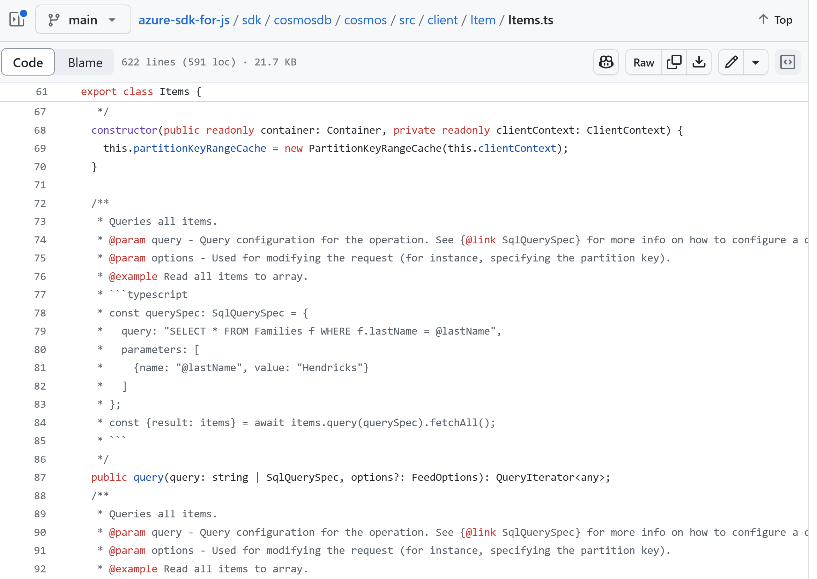
SDK Code on GitHub

Slide 12
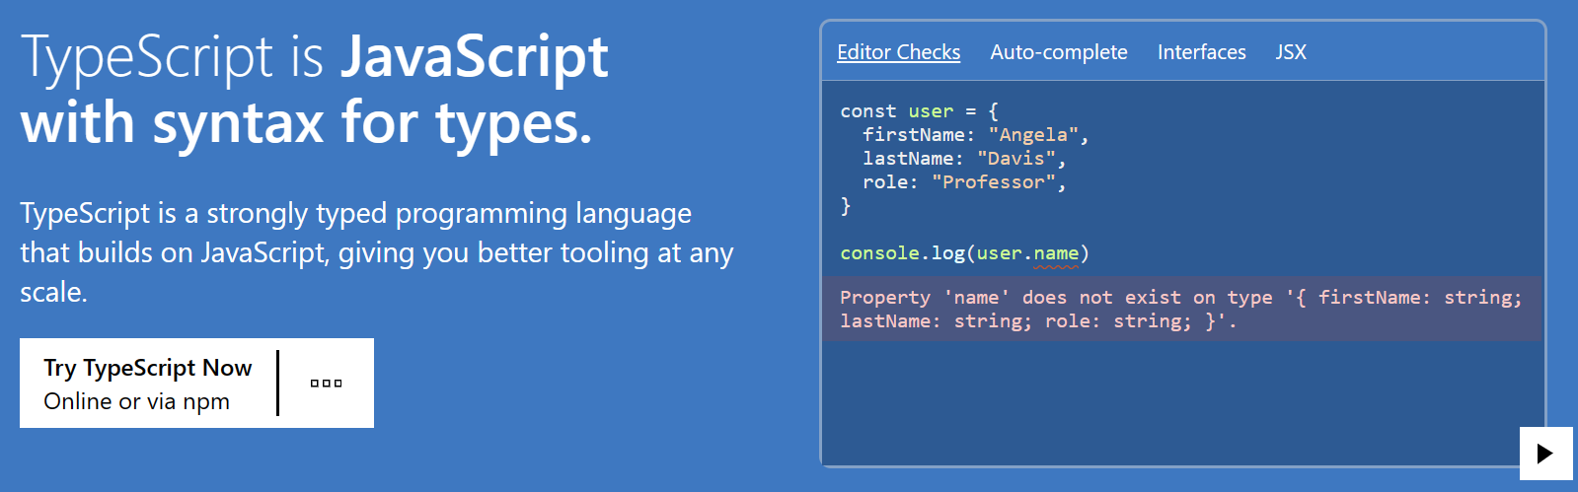
Why TypeScript?
https://www.typescriptlang.org/
Type Safety and High Productivity!

Slide 13
Why TypeScript?
Author your Code as TypeScript (with types)
“Transpile” into regular JavaScript with the tsc program
At runtime it’s just the JavaScript that executes
Catch many coding errors during development, not deployment
Great IDE Support – Visual Studio Code and GitHub Copilot
At runtime it’s just JavaScript that executes
Node.js runtime is performant, mature, lightweight
Docker Containers and Microservices
Azure Kubernetes Service (AKS), Azure Container Instances (ACI),
Azure Functions, Azure Container Apps (ACA)

Slide 14
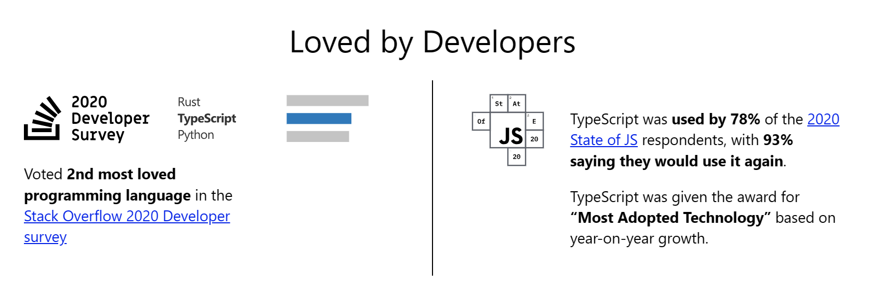
Why TypeScript? Excellent Docs, Simple to Learn, Open-Source, Loved
https://www.typescriptlang.org/docs/
Type Safety and High Productivity!
Open-Source, developed by Microsoft

Slide 15
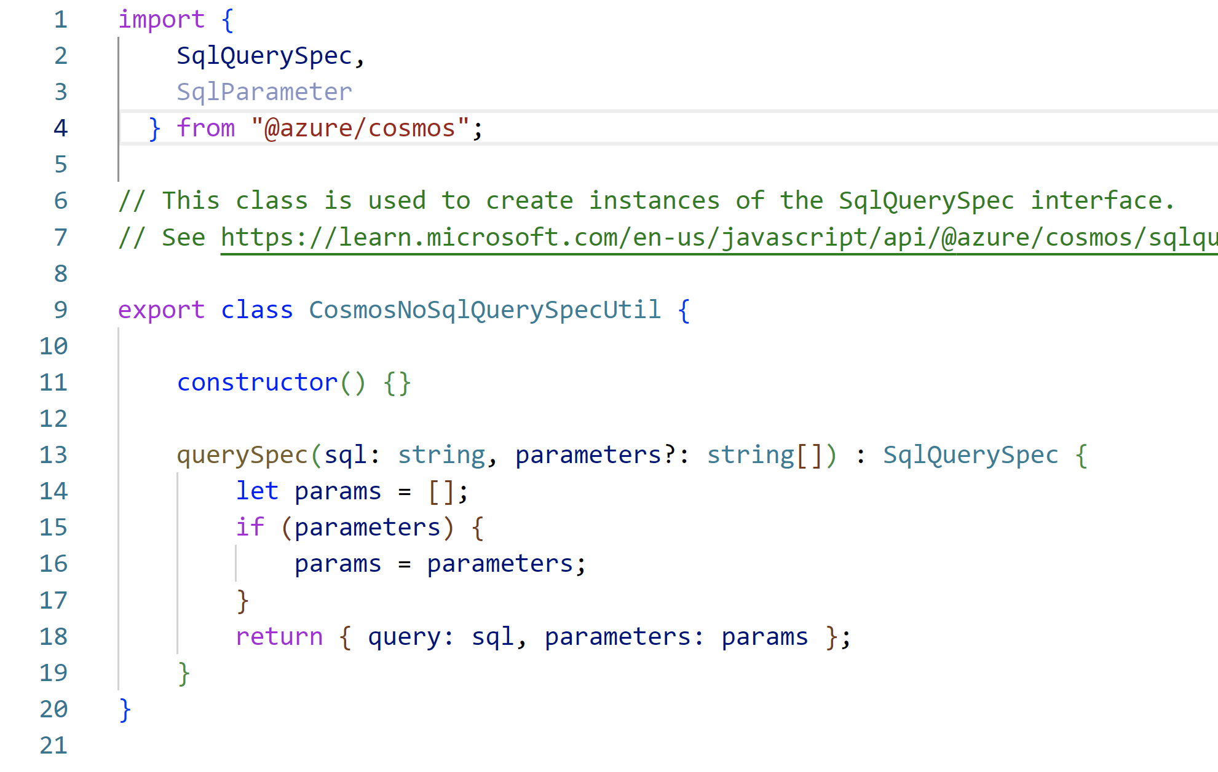
TypeScript: What does it look like?
Items of note:
- import/export statements
- classes
- constructor
- method args with types
- optional args with ?
- return type defined
- use of duck-type interfaces
- also public/private/static
- tsc compiler will complain

Slide 16
The azu-js Package @ NPM
Provides an easy to use wrapper for some Azure SDK functions
Azure Cosmos DB NoSQL API
Azure Blob Storage
Azure Cognitive Search (now AI Search)
Azure OpenAI
Also File System, Config, Logging
Provides easy to find samples of the Cosmos DB JS SDK
I use it for my many TypeScript & Cosmos DB projects
Includes Unit Tests using the Jest test framework
The Unit Tests also provide code examples
https://www.npmjs.com/package/azu-js

Slide 17
The TypeScript/Express/Cosmos DB Web Application : Code
X
The TypeScript/Express/Cosmos DB Web Application - code walkthrough and demo

Slide 18
The TypeScript/Express/Cosmos DB Web Application : Demo
X
The TypeScript/Express/Cosmos DB Web Application - code walkthrough and demo

Slide 19
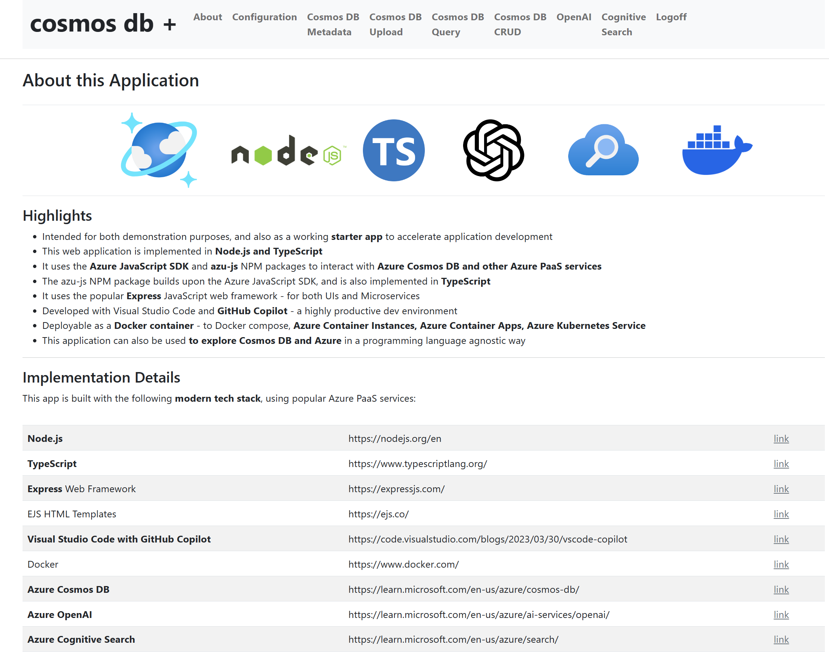
Web App Screen Shots : About

Slide 20
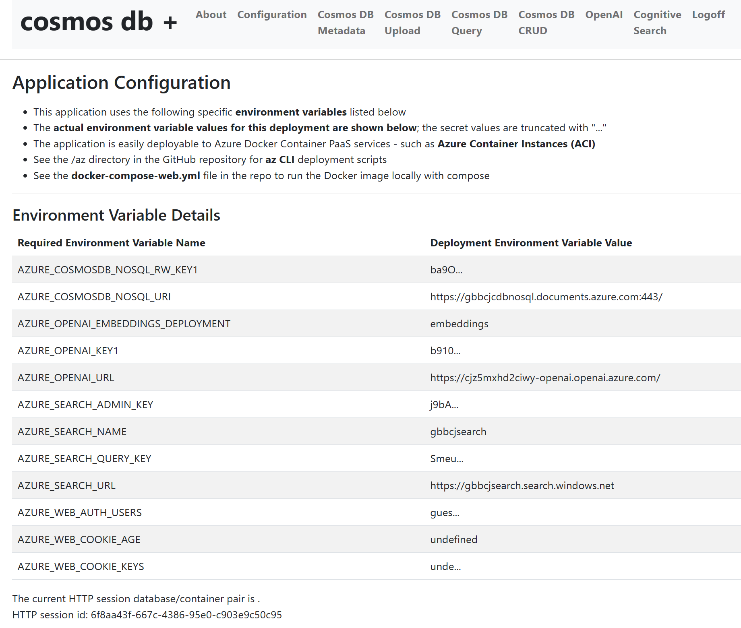
Web App Screen Shots : Configuration

Slide 21
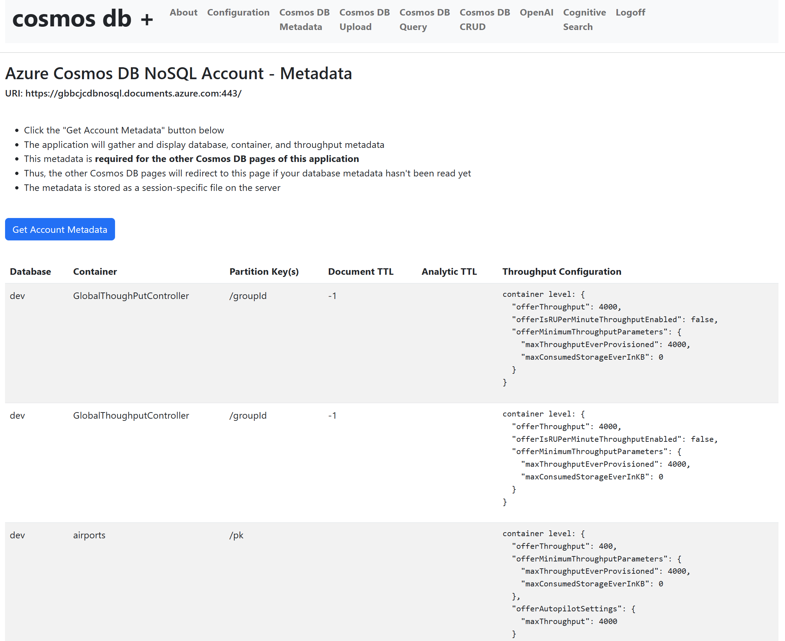
Web App Screen Shots : Cosmos DB Metadata

Slide 22
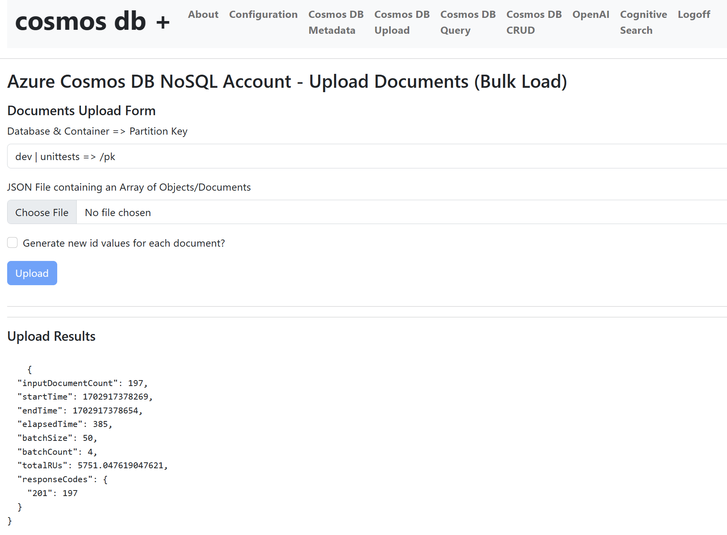
Web App Screen Shots : Cosmos DB JSON File Upload

Slide 23
Web App Screen Shots : Cosmos DB JSON Array Upload

Slide 24
Wrap Up and Links
X

Slide 25
Thank you!
Questions?

